Slide 1


PROJECT ON
Smartphones Analysis Based on Features and Brand
Presented By:
Name : KUCHANI VAMSHI
Batch : 456
Branch : DILSUKHNAGAR

Slide 2
About Me
My Name is Vamshi.
I have completed my Bachelor of Technology in Computer Science and Engineering.
Linked In : https://www.linkedin.com/in/kuchani-vamshi-14b356296/

Slide 3
Agenda
Introduction
Business Problem
Web Scrapping Details
Simple Description of Column in Dataset
Data Cleaning & Manipulation
Univariate Analysis
Bivariate Analysis
Hypothesis Testing
Recommendations
Conclusion

Slide 4
Introduction
The smartphone market is highly competitive, with prices influenced by factors such as specifications, brand value, and market positioning.
This project analyzes smartphone pricing using real-world data and data analytics techniques.
Exploratory Data Analysis (EDA) is used to study the impact of features like ROM (storage), and discounts on pricing. Visualizations help identify key trends and patterns in the data.
The insights derived support data-driven decision-making for manufacturers, retailers, and customers.

Slide 5
Business Problem
Business Problem
A mobile phone is available in multiple variants based on features such as brand, color options, internal storage (ROM), and price. Even within the same brand and similar specifications, phone prices vary significantly due to these factors.
Business Objective
To analyze smartphone pricing using real-world market data.
To identify the key factors influencing smartphone prices such as RAM, storage, and discounts
To perform Exploratory Data Analysis (EDA) to uncover trends and patterns in smartphone pricing.
To understand the relationship between specifications and price across different brands and segments.
Problem Statement
Smartphone prices vary a lot due to factors like brand, internal storage (ROM), and color options, which can confuse customers while comparing devices.

Slide 6
Web Scrapping - Details
Website Scrapped:
Shopsy (Mobiles Category Pages)
Data Source Type :
Publicly available product listing pages on Shopsy website
Tools and Technologies Used :
Python
Selenium
Regex
Pandas
Matplotlib
Seaborn

Slide 7
Simple Description of Column in Dataset
Mobile_Name: Name or model of the mobile phone.
Color: Color variant of the mobile phone.
Brand: Company or manufacturer of the mobile phone.
ROM: Internal storage capacity of the mobile phone (in GB).
MRP_Price: Original listed price of the mobile phone.
Selling_Price: Actual price at which the mobile phone is sold.
Discount: Amount or percentage reduced from the MRP price.
Category: It tells about the category of a Mobile wheather it is in Budget, Premium and Luxury.

Slide 8
Data Cleaning & Manipulation :
Handling Data Types
Droped The Null Values.
Converted the selling_price, ROM,MRP_Price To Absolute Values.
Droped the Brand column from the data set and extracted the brand Name From Mobile_Name.
Removed inconsistent data and made it to consistent and changed the data type of a column object to numeric or int.
Standardizing the data and reset the data.
New Created columns
Created a new column which tells about the segment of the mobile weather it is budget, Premium and Luxury.
Handling Missing Values
Filled the Missing Values in the Brand Column by using the Mobile Name Column.
Outlier & Data Consistency Check:
Used boxplot to detect outliers, found negative values in some columns.
Converted negative values to Positive using absolute value.

Slide 9
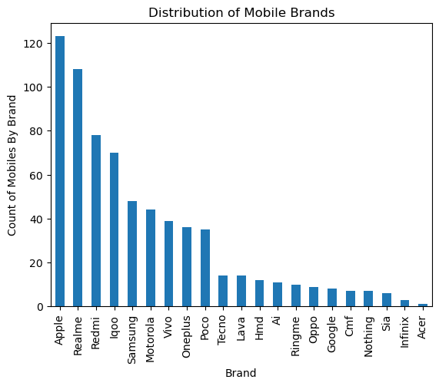
Univariate Analysis
Insight :
Here From the above Visual We know That what is the Count of Mobile By the Brand, the dataset is dominated by Apple and Realme models, while most other brands have significantly fewer mobile models listed.

Slide 10
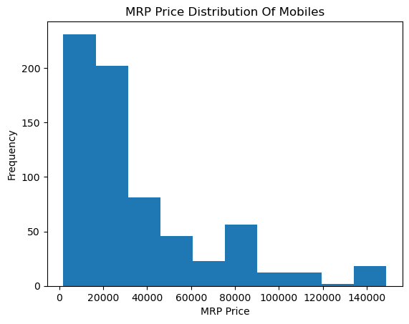
MRP Price Distribution
Insights:
Here From The Above Visual i.e how the is distributed and count of Mobiles in that Price Range.
Most Of the Phones are in the Range of 2k to 30K.
Moderate Number Phones Phones are lied between 49K to 90k.
Few are lied in the range of 90k to 140K+.

Slide 11
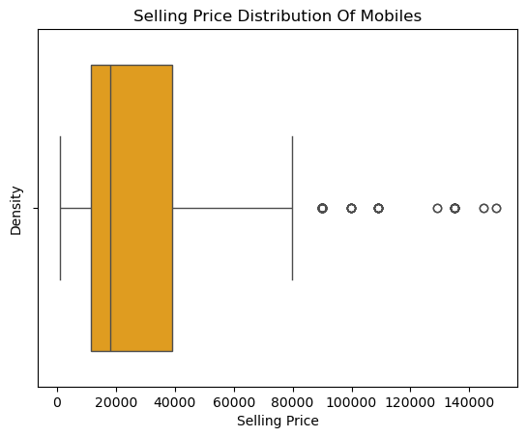
Selling Price Distribution Of Mobile
Insights:
Most mobile phones are priced in the lower to mid price range, showing that affordable models dominate the market. A few very high-priced phones appear as outliers, indicating the presence of premium flagship models.

Slide 12
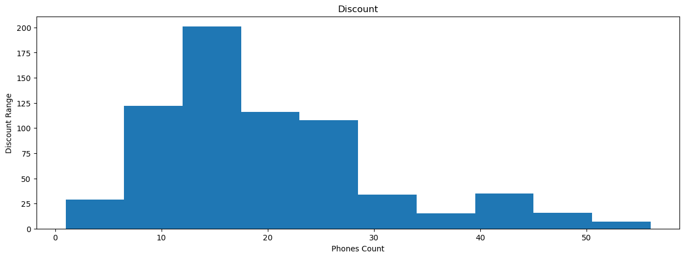
Distribution of Discounts on Mobile Phones
Insights:
Most mobile phones have discounts in the low to medium range, mainly between about 5% and 25%.
Very high discounts are rare, which suggests heavy discounting is offered only on a few models.

Slide 13
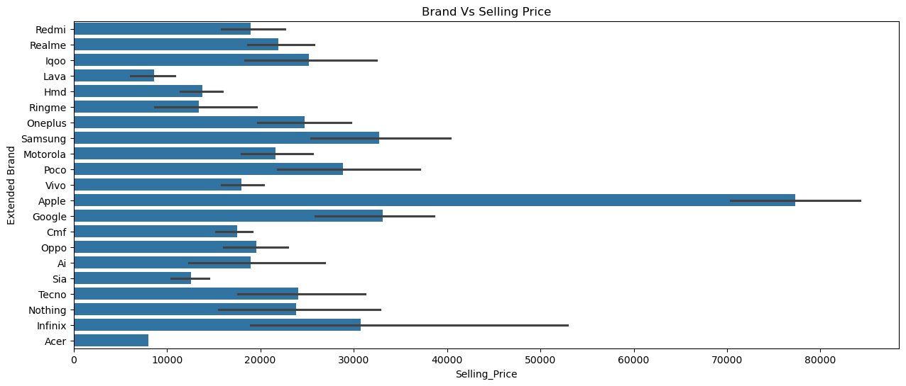
Brand vs Selling Price
Poco
OnePlus
Iqoo
Nothing
Infinix
Mostly fall in the ₹20k–₹35k range
Insights:
Apple dominates the premium segment, it has the highest average selling price by a huge margin,
This clearly shows Apple’s premium brand positioning and strong pricing power. Samsung & Google sit in the upper-mid to premium range Samsung and Google prices are significantly higher than most Android brands.

Slide 14
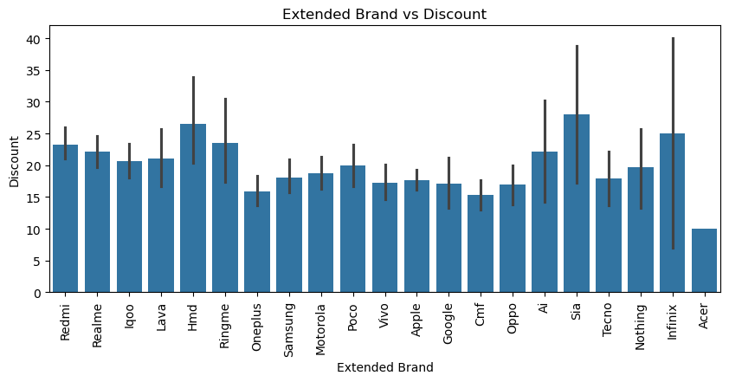
Brand Vs Discount
Insights :
Budget and mid-range brands like Redmi, Realme, Lava, and HMD offer moderate to high discounts.
OnePlus, Apple, and Google provide lower discounts, showing strong brand value and less dependence on price cuts.

Slide 15
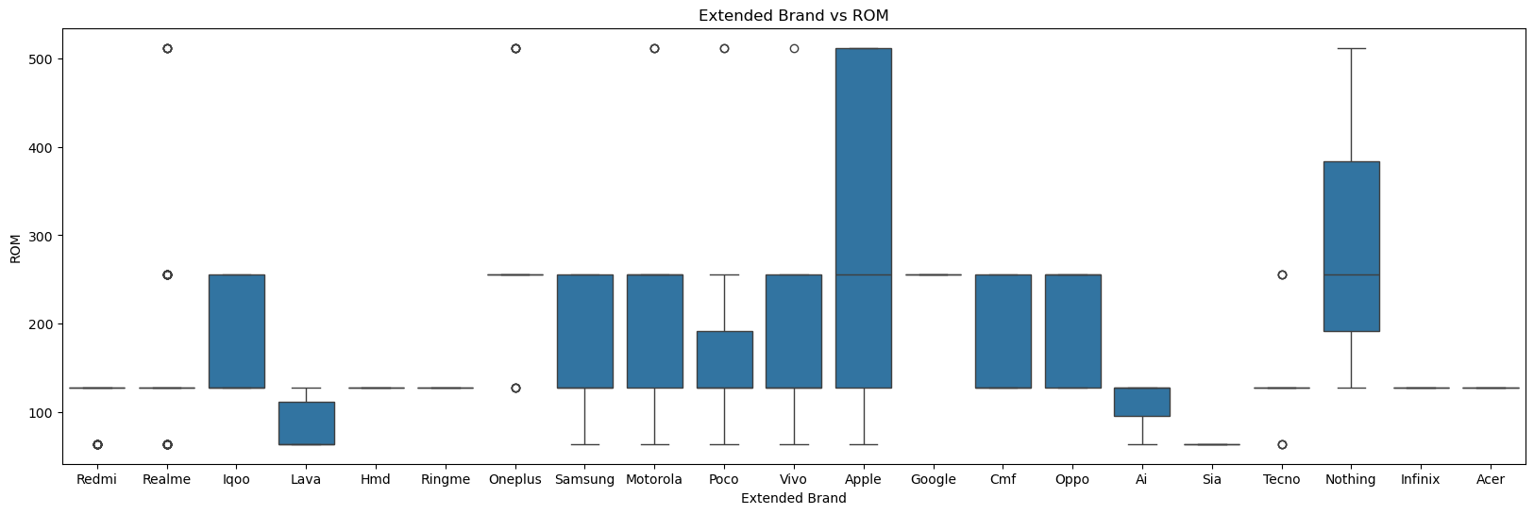
Brand Vs ROM(Storage)
Insights :
Apple and Nothing offer phones with the highest ROM options, including very high storage variants.
Samsung, Motorola, Oppo, Vivo, and Poco provide a wide range of ROM, showing multiple models at different storage levels.
Redmi, Realme, HMD, and mostly have fixed or limited ROM options, usually in lower storage ranges.
Budget brands like Lava, Sia, and Ai mainly offer lower ROM, suitable for basic users.
Google and CMF focus on mid-level ROM, with fewer variations.

Slide 16
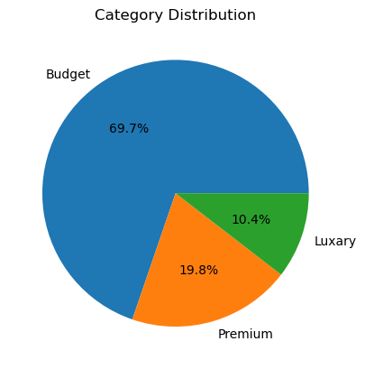
Category Distribution Of Mobiles
Insights
Most phones are Budget category (69.7%), showing the market mainly focuses on low-price customers.
Premium phones form a smaller share (19.8%), targeting users who want better features and performance.
Luxury phones are very few (10.4%), indicating a niche market with limited demand.

Slide 17
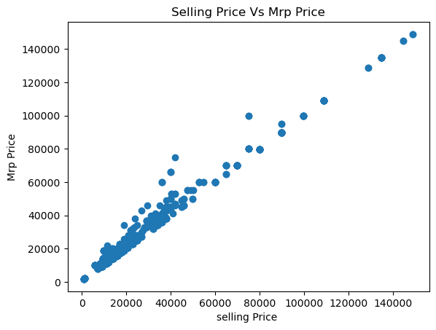
Selling Price Vs MRP Price
Insight :
Selling price and MRP move together, showing a strong positive relationship, Most phones are in the budget and mid-price range, clustered at lower values, High-priced phones are fewer and appear at the top-right of the chart.

Slide 18
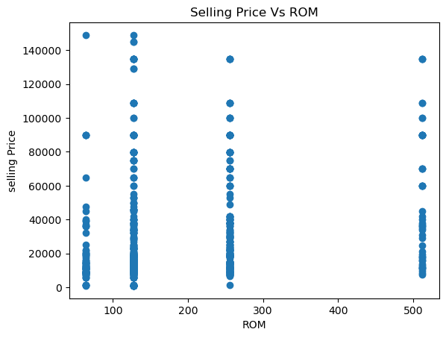
Selling Price Vs ROM(Storage)
Insight :
Phones with higher ROM generally have higher prices, but the relationship is not perfectly linear.
For the same ROM size, prices vary a lot, showing that brand and features also affect price.
Most phones are clustered around 128 GB and 256 GB ROM, indicating these are the most common options.
Very high-priced phones exist at higher ROM levels, but they are fewer in number.

Slide 19
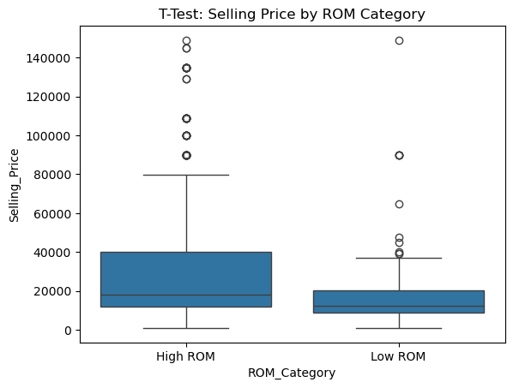
Hypothesis Testing
Do mobiles with higher storage (ROM) have higher selling prices?
Conclusion :
Reject Null Hypothesis : ROM impacts selling price

Slide 20
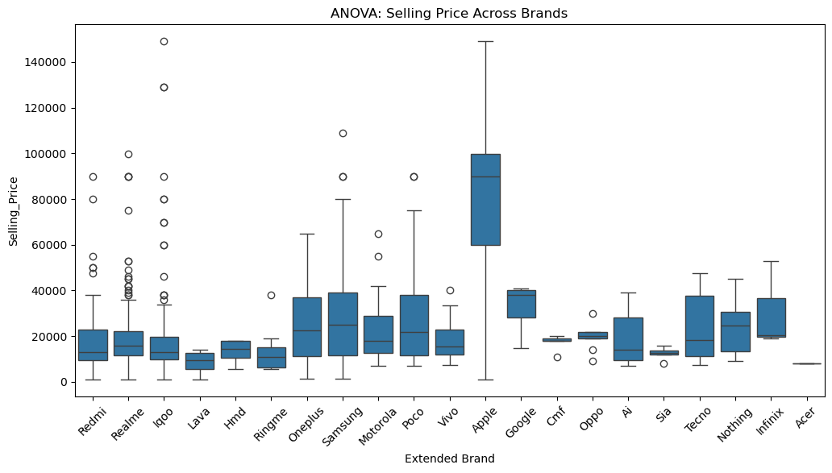
Hypothesis Testing
Does mobile phone price vary significantly across brands?
Conclusions :
Reject Null Hypothesis : Brand significantly impacts price

Slide 21
Recommendations
Focus on optimizing specifications rather than only increasing prices.
Mid-range phones with strong processors and balanced features have the highest demand.
Improve transparency in specifications to attract informed customers.
Promote phones with high performance at lower prices to boost conversions.
Customers should compare phones based on specifications and value, not just brand.
Mid-range smartphones often deliver near-flagship performance at a much lower cost.

Slide 22
Conclusions :
The smartphone market is dominated by budget and mid-range phones, with most devices priced below ₹30,000.
Brand plays a major role in pricing, where Apple clearly dominates the premium segment, while brands like Redmi, Realme, Poco, and iQOO focus on value-for-money models.
Selling prices are consistently lower than MRP, proving that discounts significantly influence final customer purchase decisions.
Phones with higher ROM generally cost more, but price differences also depend heavily on brand positioning and additional features.
Discount strategies vary by brand: budget brands offer higher discounts, while premium brands rely less on price cuts due to strong brand value.
Statistical tests (T-test and ANOVA) confirm that brand and storage capacity have a significant impact on smartphone pricing.

Slide 23
Any
Questions?

Slide 24

THANK YOU

